Slide 1


7.6 Secure E-mail
Network Security / G.Steffen

Slide 2

In This Section
Threats to E-mail
E-mail Protection List
Overview of Encrypted E-mail Processing
Example Secure E-mail Systems 2
Network Security / G.Steffen

Slide 3
Threats to E-mail
Message interception (confidentiality)
Message interception (blocked delivery)
Message interception & subsequent replay
Message content modification
Message origin modification
Message content forgery by outsider
Message origin forgery by outsider
Message content forgery by recipient
Message origin forgery by recipient
Network Security / G.Steffen

Slide 4
E-mail Protection List
Message confidentiality
  The message is not exposed en route to the receiver
Message integrity
  What the receiver sees is what was sent
Sender authenticity
  The receiver is confident who the receiver was
Nonrepudiation
  The sender cannot deny having sent the message
Network Security / G.Steffen

Slide 5
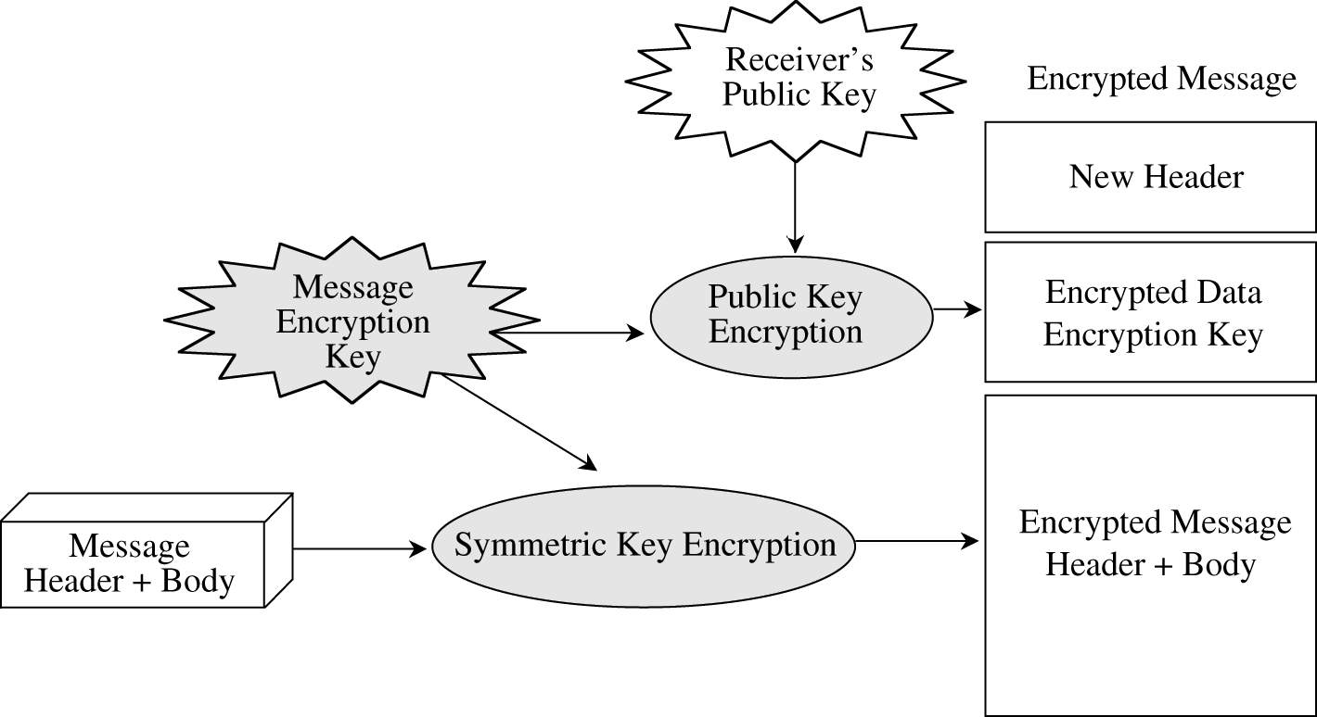
Overview of Encrypted E-mail Processing
The encrypted e-mail
standard supports multiple
encryption algorithm.
Encrypted e-mail messages
always carry a digital signature.
Encrypted e-mail processing
can integrate with ordinary e-
mail packages
The major problem with
encrypted email is key
management
Message Integrity Check (MIC) – A hash function in the digital signature
Network Security / G.Steffen

Slide 6
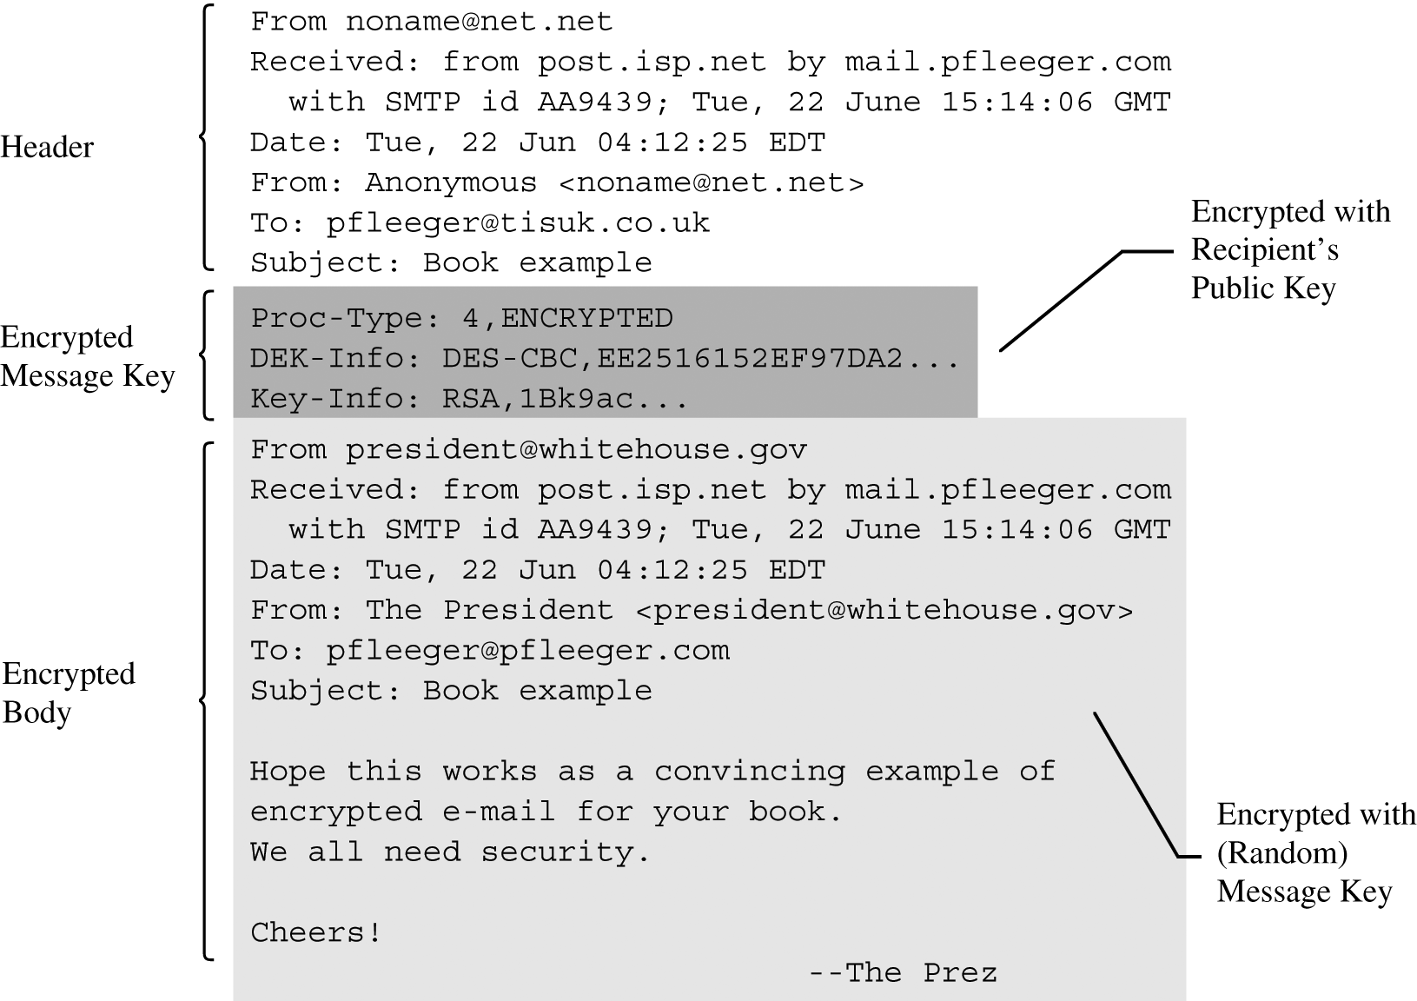
Encrypted E-Mail–Secured Message
Network Security / G.Steffen

Slide 7
Example Secure E-mail Systems 1
Pretty Good Privacy (PGP)
  Invented by Phil Zimmerman in 1991
  It is heavily used by individuals exchanging private e-mail
  It addresses the key distribution problem with what is called “ring of trust” or a users “keyring”
  It does not mandate a policy for establishing trust
  Some of it actions include:
    Creating a random session key for a symmetric algorithm
    Encrypting the message
    Encrypting the session key under the recipients public key
    Transmit the message to the recipient
Network Security / G.Steffen

Slide 8
Example Secure E-mail Systems 2
Secure Multipurpose Internet Mail Extensions (S/MIME)
  It is the internet standard for secure e-mail attachments.
  It uses hierarchically validated certificates for key exchange.
  It works with a variety of cryptographic algorithms such as DES, AES & RC2 fir symmetric encryption.
Network Security / G.Steffen

